Slide 1
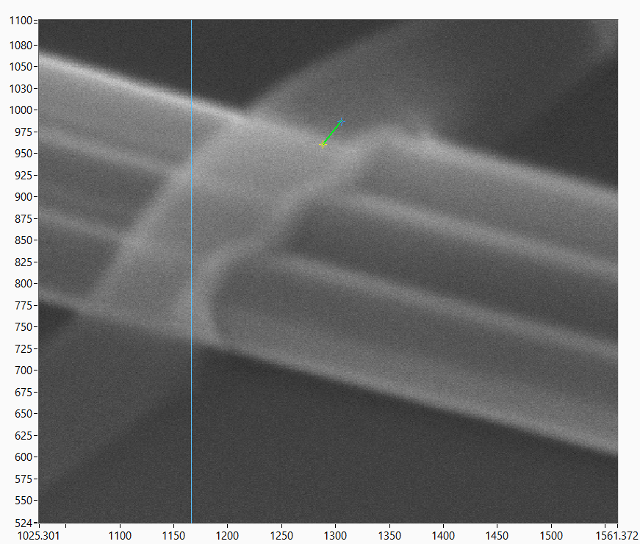
CM01: gap 9_004.jpg
52 deg tilt
1 minute milling (no including ca 5s ramp up/down of acc. Voltage)
20 nm
52 deg tilt: scale to sin(52) = 0.79
20 nm/0.79 = 25 nm
Mill rate: 25 nm/minute
15s: ca 6 nm
Note: faceting/rounding etc may play a trick.

Slide 2
From Christian Juengers thesis:
The Ar+ etching can be done in-situ in two different systems.
In Balzers:
1. Base pressure: 2 × 10−7 mbar
2. Ar flow: 3.2 sccm
3. Process background pressure: 5 × 10−5 mbar
4. Ar plasma: Recipe 2
5. Ar Beam current: 20mA
6. Ar Beam voltage: 500V
7. etch time: 23 s (stage perpendicular to Ar source)
In Bestec:
1. Base pressure: 5 × 10−7 mbar
2. Ar flow: adjust needle valve to get constant background pressure
3. Process background pressure: 5 × 10−5 mbar
4. Plasma power: adjust voltage such as output current is 20mA
5. Extraction voltage: −0.6 kV
6. Anode voltage: 1 kV
7. Etch time: 150 s
Claes: I think we should explore even lower acceleration voltages (<500), and maybe lower current (right now 35 mA).

